Slide 1
Heuristic functions
A heuristic function is a function that maps from problem state descriptions to measures of desirability, usually represented as numbers
Well designed heuristic function play an important role in guiding a search process toward a solution.
In chess heuristic function should be high whereas in travelling salesman it is low.

Slide 2
The purpose of heuristic function is to guide the search process in profitable direction by suggesting which path to follow first when more than one is available.
There is a trade off between the cost of evaluating a heuristic function and the savings in search time that the function provides.

Slide 3
Heuristic search

Slide 4
A heuristic search is a technique that improves the efficiency of a search process by sacrificing claims of completeness. Heuristics are like our tour guides.
Using good heuristics we can get good possible non optimal solutions to hard problems in less than exponential time.

Slide 5
Heuristic search
→ Generate-and-test
→ Hill climbing
→ Best-first search
→ Problem reduction
→ Constraint satisfaction
→ Means-ends analysis
44

Slide 6
Algorithm : Generate-and-Test
Generate a possible solution.
Test to see if this is actually a solution by comparing the chose point or the endpoint of the chosen path to the set of acceptable goal states.
If a solution has been found, quit. Otherwise, return to step 1.
45

Slide 7
GENERATE-AND-TEST
Acceptable for simple problems.
  Eg : 1. finding key of a 3 digit lock.
      2. 8-puzzle problem
Inefficient for problems with large space.
Use DFS as all possible solution generated, before they can be tested.

Slide 8
GENERATE-AND-TEST
Generate solution randomly: British museum algorithm; wandering randomly.
Exhaustive generate-and-test. : consider each case in depth
Heuristic generate-and-test: not consider paths that seem unlikely to lead to a solution.
Plan generate-test:
− Create a list of candidates.
− Apply generate-and-test to that list on the basis of constraint-satisfaction.
Ex – DENDERAL, which infers the structure of organic compounds using mass spectrogram and nuclear magnetic resonance (NMR) data.

Slide 9
HILL CLIMBING
Generate-and-test + direction to move (feedback from test procedure).
Test function + heuristic function = Hill Climbing
Heuristic function (objective function) to estimate how close a given state is to a goal state.
Hill climbing can be used to solve problems that have many solutions but where some solutions are better than others.
Hill climbing is often used when a good heuristic function is available for evaluating states but when no other useful knowledge is available.
Example: In Travelling salesman, straight line (as crow flies) distance between two cities can be a heuristic measure of remaining distance.
Like heuristic value is measure of remaining cost from current state to goal state.

Slide 10
SIMPLE HILL CLIMBING
Evaluation function as a way to inject task-specific knowledge into the control process.
Key difference between Simple Hill climbing and Generate-and-test is the use of evaluation function as a way to inject task specific knowledge into the control process.
Better : higher value of heuristic function
Lower value

Slide 11
Algorithm : Simple Hill-Climbing
1. Evaluate the initial state. If it is also a goal state, then return it and quit. Otherwise, continue with the initial state as the current state.
2. Loop until a solution is found or until there are no new operators left to be applied in the current state:
Select an operator that has not yet been applied to the current state and apply it to produce a new state.
(b) Evaluate the new state.
  If it is a goal state, then return it and quit.
(ii) If it is not a goal state but it is better than the current state, then make it the current state.
(iii) If it is not better than the current state, then continue in the loop.
46

Slide 12
EX
Use heuristic function as measure of how far off the number of tiles out of place.
Choose rule giving best increase in function.
2
8
3
1
2
3
1
6
4
8
4
7
5
7
6
5

Slide 13
Example
-4
-3
-3
2
8
3
U
2
8
3
U
2
3
L
1
6
4
1
4
1
8
4
7
5
7
6
5
7
6
5
-2
-1
0
2
3
D
1
2
3
R
1
2
3
1
8
4
8
4
8
4
7
6
5
7
6
5
7
6
5

Slide 14
STEEPEST-ASCENT HILL CLIMBING
Considers all the moves from the current state.
Selects the best one as the next state.
Also known as Gradient Search.

Slide 15
Algorithm : Steepest-Ascent Hill Climbing or gradient search
Evaluate the initial state. If it is also a goal state, then return it and quit. Otherwise, continue with the initial state as the current state.
2. Loop until a solution is found or until a complete iteration produces no change to current state:
Let SUCC be a state such that any possible successor of the current state will be better than SUCC.
(b) For each operator that applies to the current state do:
  Apply the operator and generate a new state.
  (ii) Evaluate the new state. If it is a goal state, then return it and quit. If not, compare it to SUCC. If it is better, then set SUCC to this state. If it is not better, leave SUCC alone.
(c) If the SUCC is better than current state, then set current state to SUCC.
47

Slide 16
HILL CLIMBING: DISADVANTAGES
Fail to find a solution
Either Algorithm may terminate not by finding a goal state but by getting to a state from which no better state can be generated.
This happen if program reached
  Local maximum: A state that is better than all of its neighbours, but not better than some other states far away.
  Plateau: A flat area of the search space in which all neighbouring states have the same value.
  Ridge: Special kind of local maximum. It is an area of search space that is higher than surrounding areas but cannot be traversed by single moves in any one direction. Means move in several directions at once.
The orientation of the high region, compared to the set of available moves, makes it impossible to climb up.

Slide 17

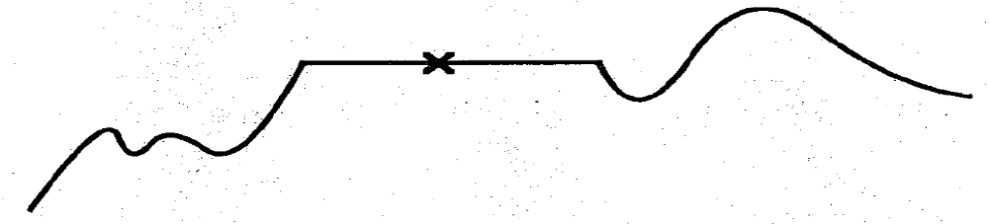
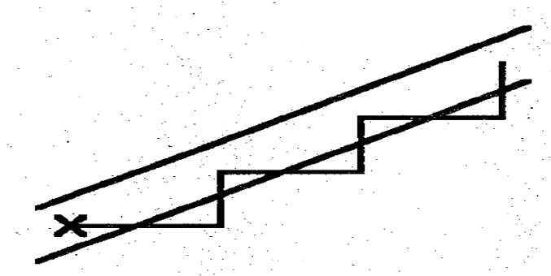
Hill-Climbing Dangers
· Local maximum
· Plateau
· Ridge
48

Slide 18
HILL CLIMBING: DISADVANTAGES
Ways Out
Backtrack to some earlier node and try going in a different direction. (good way in dealing with local maxima)
Make a big jump to try to get in a new section. (good way in dealing with plateaus)
Moving in several directions at once. (good strategy for dealing with ridges)

Slide 19
HILL CLIMBING: DISADVANTAGES
Hill climbing is a local method:
Decides what to do next by looking only at the “immediate” consequences of its choices rather than by exhaustively exploring all the consequences.
Global information might be encoded in heuristic functions.

Slide 20
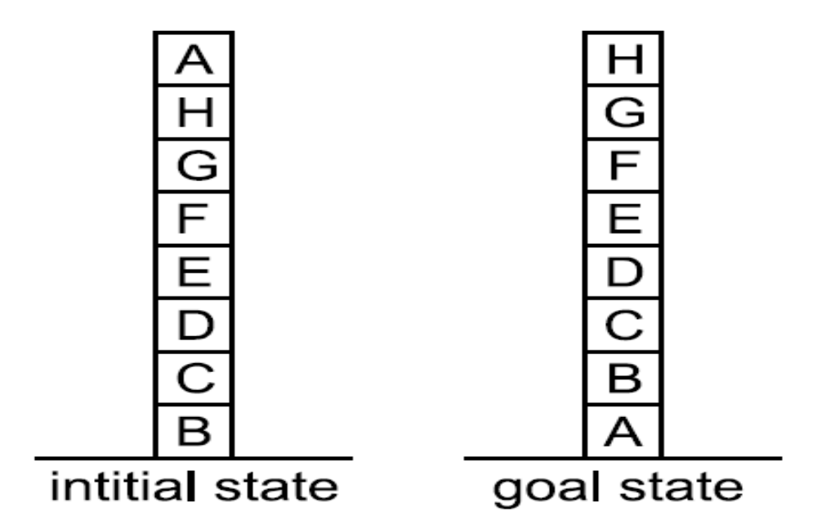
A Hill-Climbing Problem
Local: Add one point for every block that is resting on thing it is supposed to be resting on.
Subtract one point from every block that is sitting on wrong thing.
4
8
49

Slide 21
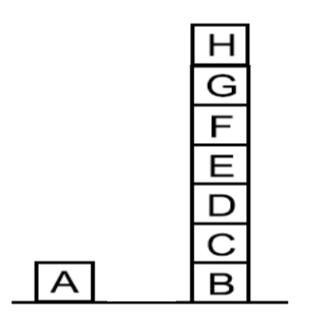
One Possible Moves
6
50

Slide 22
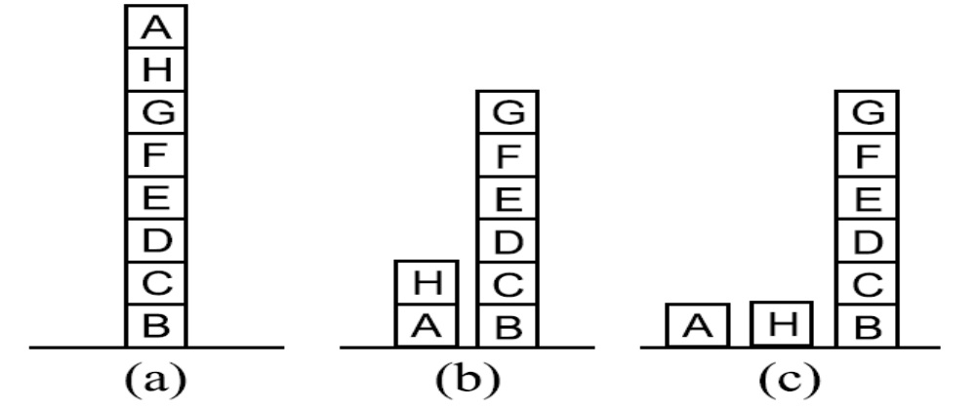
Three Possible Moves
4
4
4
Hill Climbing will Halt because all states have lower score than the Current state.
50

Slide 23
A Hill-Climbing Problem
Global: Add one point for every block in correct support structure, subtract one point for every
block in existing support structure.
-28
28
49

Slide 24
One Possible Moves
-21
50

Slide 25
Three Possible Moves
-28
-16
-15
50

Slide 26
SIMULATED ANNEALING
A variation of hill climbing in which, at the beginning of the process, some downhill moves may be made.
To do enough exploration of the whole space early on, so that the final solution is relatively insensitive to the starting state.
Lowering the chances of getting caught at a local maximum, or plateau, or a ridge.
The term simulated annealing derives from the roughly analogous physical process of heating and then slowly cooling a substance to obtain a strong crystalline structure.
  The simulated annealing process lowers the temperature by slow stages until the system ``freezes" and no further changes occur.

Slide 27
SIMULATED ANNEALING
Probability of transition to higher energy state is given by function:
  P = e ^{–∆E/kT}
  ^{Where ∆E is} the positive change in the energy level
  T is the temperature
  K is Boltzmann constant.
  Suppose k=1,
  P’ = e ^{–∆E/T}
  Annealing schedule: if the temperature is lowered sufficiently slowly, then the goal will be attained.

Slide 28
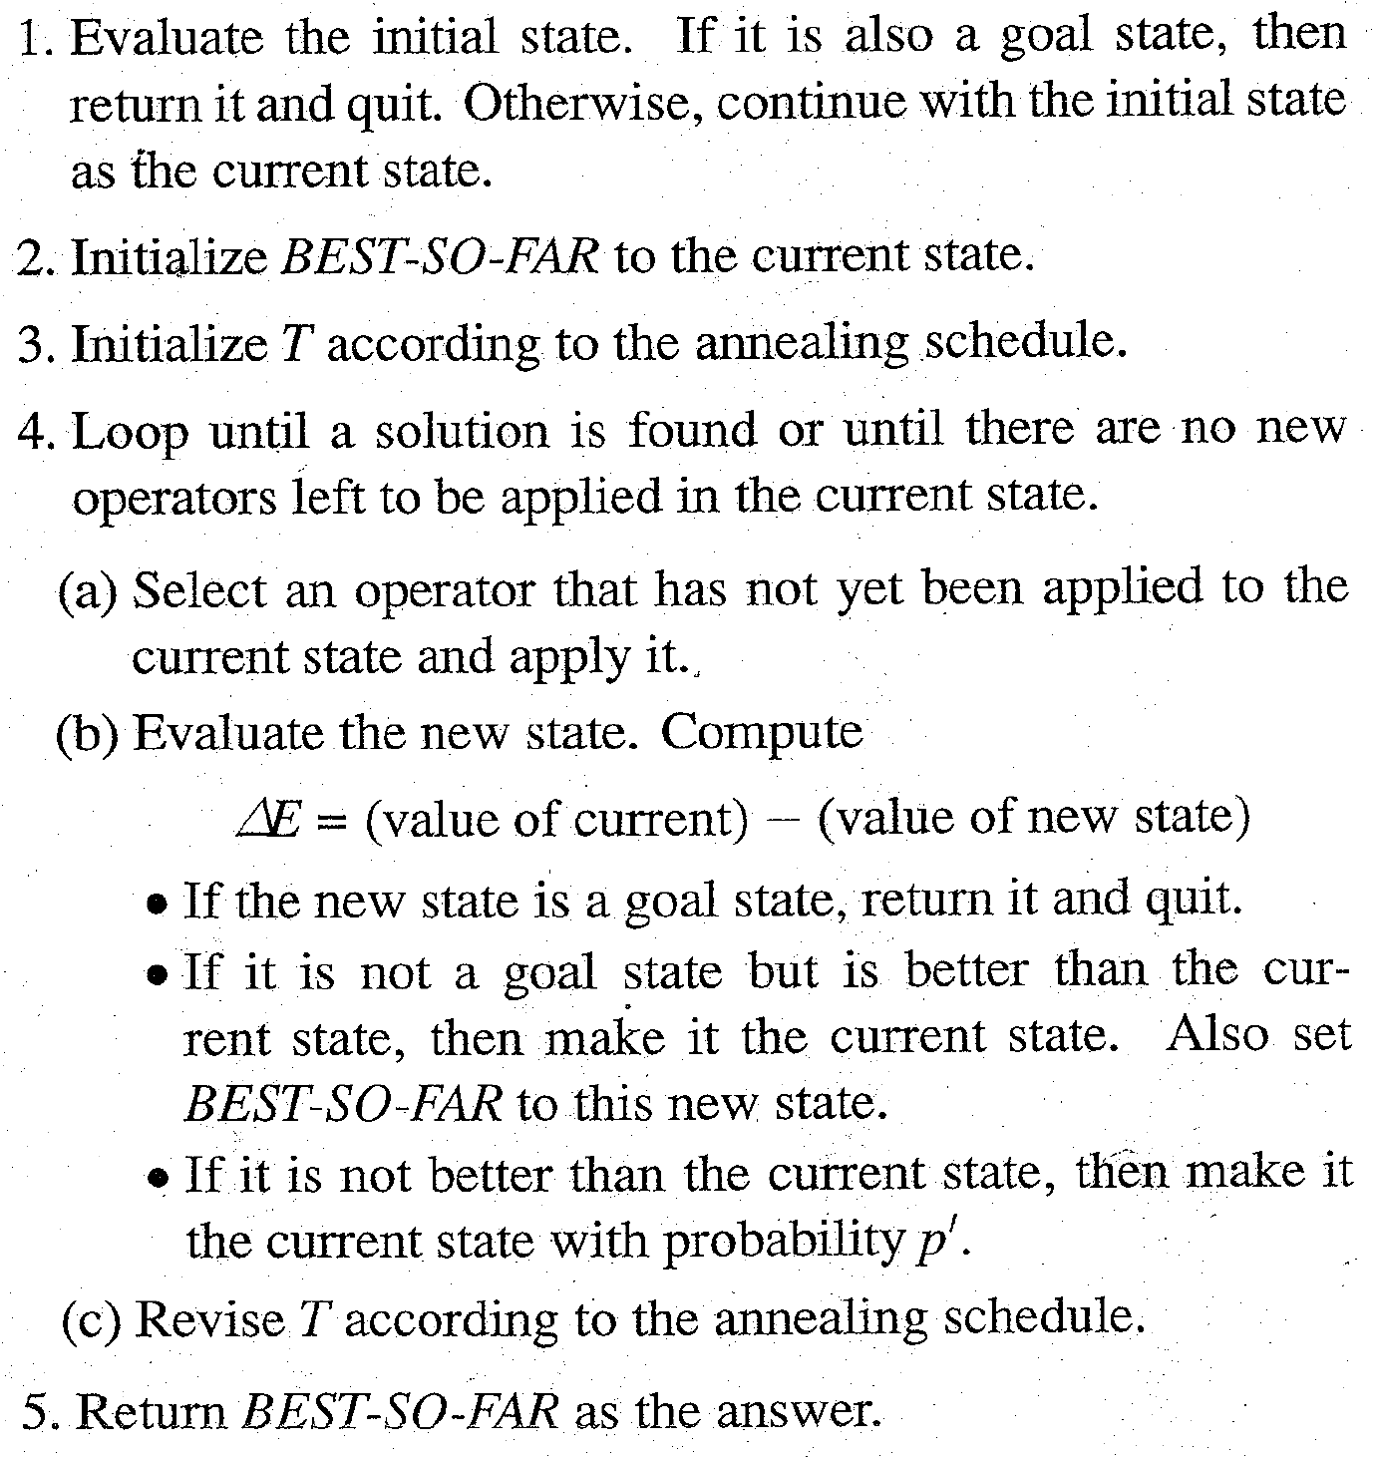
Algorithm : Simulated Annealing
52

Slide 29
SIMULATE ANNEALING: IMPLEMENTATION
It is necessary to select an annealing schedule which has three components:
  Initial value to be used for temperature
  Criteria that will be used to decide when the temperature will be reduced
  Amount by which the temperature will be reduced.

Slide 30


